Slide 1
SYSTEM HACKING/ exploitation.
Presentation subtitle

Slide 2

What is SYSTEM HACKING/ exploitation?
System hacking is defined as the compromise of computer systems and software to gain access to the target computer and steal or misuse their sensitive information.

Slide 3
SYSTEM HACKING/ exploitation cont…
The malicious hacker exploits the weaknesses in a computer system or network to gain unauthorized access of its data or take illegal advantage of it.

Slide 4
Objectives of SYSTEM HACKING/ exploitation.
It aims to achieve a connection with the target by exploiting:
Opened vulnerable ports
Operating systems
Applications
Misconfigurations.

Slide 5
HOW TO ACHIEVE SYSTEM HACKING/ exploitation.
This can be achieved through:
Payloads
Exploits
Unauthorized access

Slide 6
WHAT IS AN EXPLOIT?
An exploit is a program or piece of code that finds and takes advantage of a security flaw in an application or system so that cybercriminals can use it for their benefit, i.e., exploit it.

Slide 7
WHAT IS AN EXPLOIT? CONT…
So are exploits a form of malware? Technically, no. Exploits are not malware themselves, but rather methods for delivering the malware.
An exploit kit doesn’t infect your computer. But it opens the door to let the malware in.

Slide 8
TYPES OF EXPLOITS.
Exploits can be grouped into two categories:
known and
unknown, also called zero-day exploits

Slide 9
TYPES OF EXPLOITS CONT…
Known exploits
Known exploits are exploits that security researchers have already discovered and documented.
These exploits take advantage of the known vulnerabilities in software programs and systems (that perhaps users haven’t updated in a long time).

Slide 10
TYPES OF EXPLOITS CONT…
Known exploits
Security professionals and software developers have already created patches for these vulnerabilities,
It can be difficult to keep up with all the required patches for every piece of software—hence why these known exploits are still so successful.

Slide 11
TYPES OF EXPLOITS CONT…
Unknown exploits,
Also referred to zero-days, they are used on vulnerabilities that have not yet been reported to the general public.
This means that cybercriminals have either spotted the flaw before the developers noticed it, or they’ve created an exploit before developers get a chance to fix the flaw.

Slide 12
TYPES OF EXPLOITS CONT…
Unknown exploits,
In some cases, developers may not even find the vulnerability in their program that led to an exploit for months, if not years.
Zero-days are particularly dangerous because even if users have their software fully updated, they can still be exploited, and their security can be breached.

Slide 13
CATEGORY OF EXPLOITS.
Categories of exploits:
Remote Exploits
Local Exploits

Slide 14
CATEGORY OF EXPLOITS CONT…
Remote Exploits:
These are the type of exploits where you don’t have access to a local system or network.
Hackers use remote exploits to gain access to systems that are located at remote places.

Slide 15
CATEGORY OF EXPLOITS CONT…
Local Exploits
Local exploits are generally used by a system user having access to a local system, but who wants to overpass his rights.

Slide 16

WHAT IS A PAYLOAD?.
A payload is a custom code that attacker want the system to execute and that is to be selected and delivered by the Framework.
A payload could also be something as simple as a few commands to be executed on the target operating system.

Slide 17

let's get hands-on.
There are two types of companies: those who have been hacked, and those who don’t yet know they have been hacked.

Slide 18
Social engineering DEMO: CREDENTIALS CAPTURE.

Slide 19

CREDENTIALS CAPTURE through social engineering.
Let us trick our target through social engineering. We will use set toolkit to clone a legit website.

Slide 20
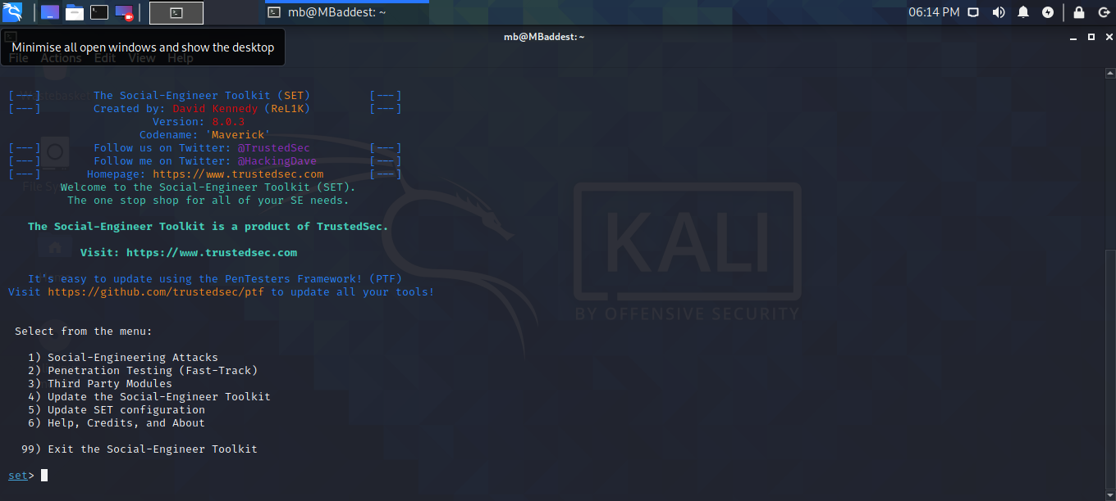
CREDENTIALS CAPTURE USING SETOOLKIT.
Using Social-Engineer Toolkit as our tool.
Run setoolkit on the terminal

Slide 21
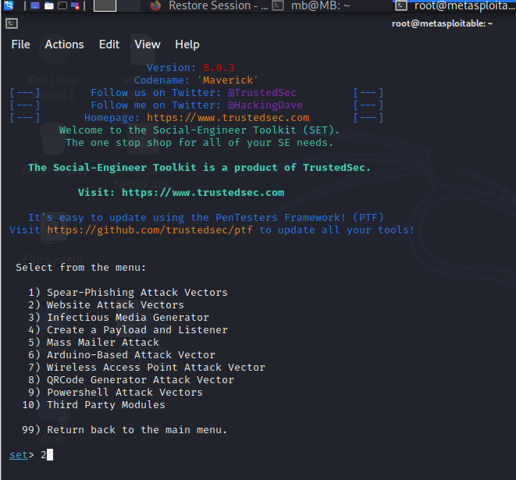
CREDENTIALS CAPTURE USING SETOOLKIT.
Select option 2

Slide 22
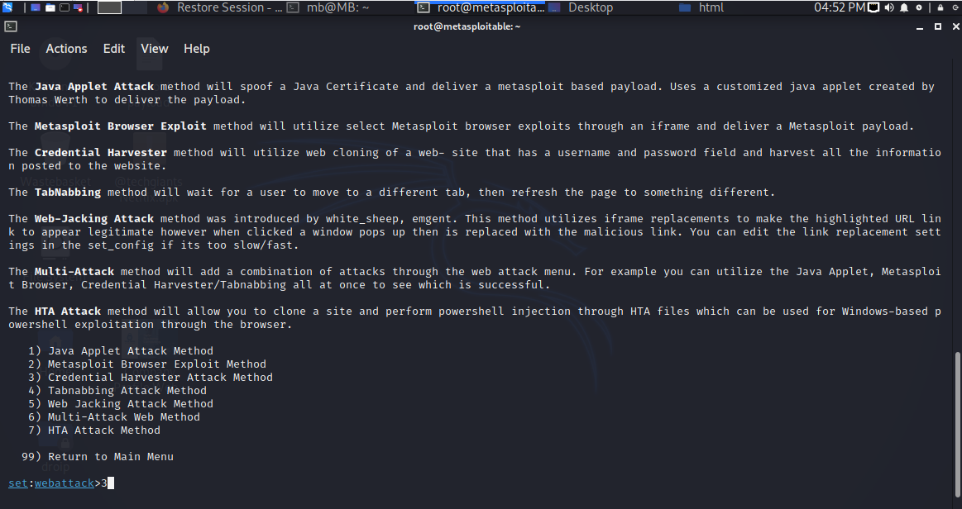
CREDENTIALS CAPTURE USING SETOOLKIT.
Select option 3

Slide 23
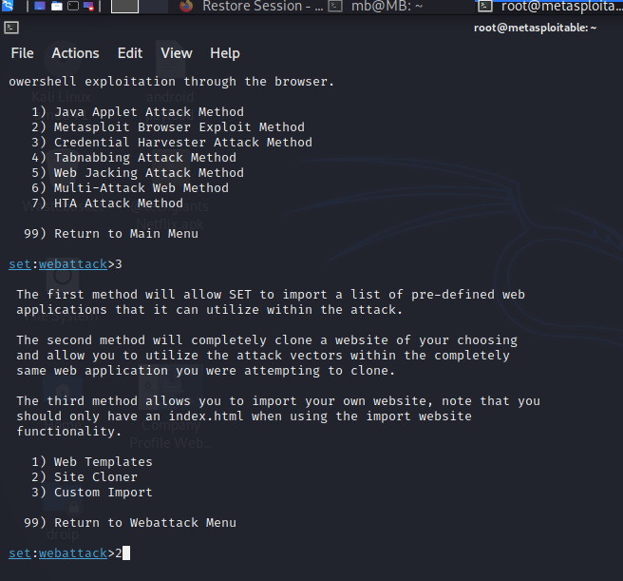
CREDENTIALS CAPTURE USING SETOOLKIT.
Select option 1

Slide 24
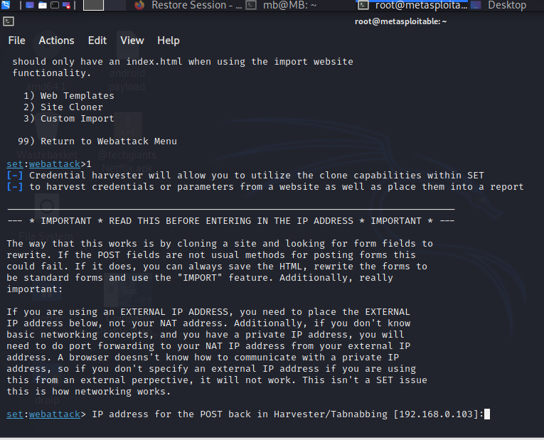
CREDENTIALS CAPTURE USING SETOOLKIT.
Confirm or change IP address.

Slide 25
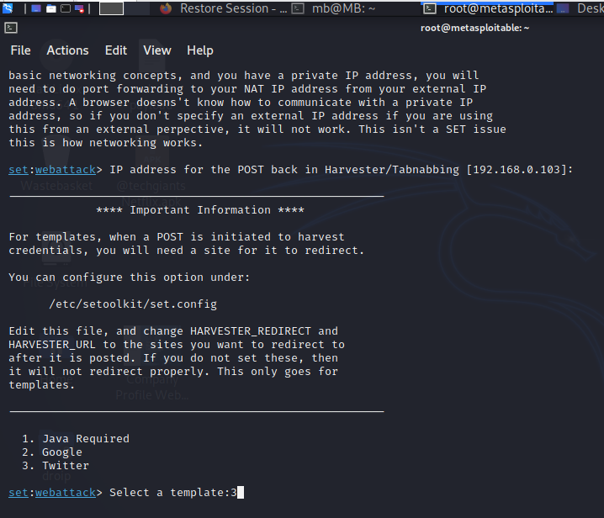
CREDENTIALS CAPTURE USING SETOOLKIT.
Select a template.
Choose option 3 in our case twitter login page

Slide 26
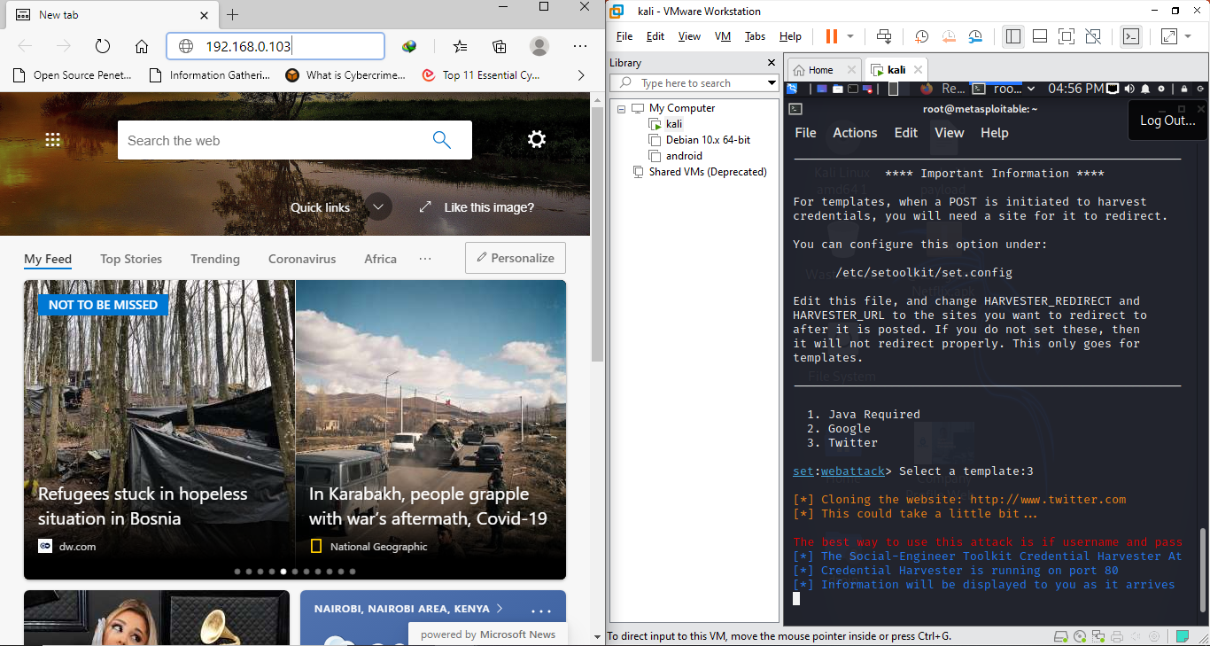
CREDENTIALS CAPTURE USING SETOOLKIT.
The target will access our IP address which will return twitter login page.

Slide 27
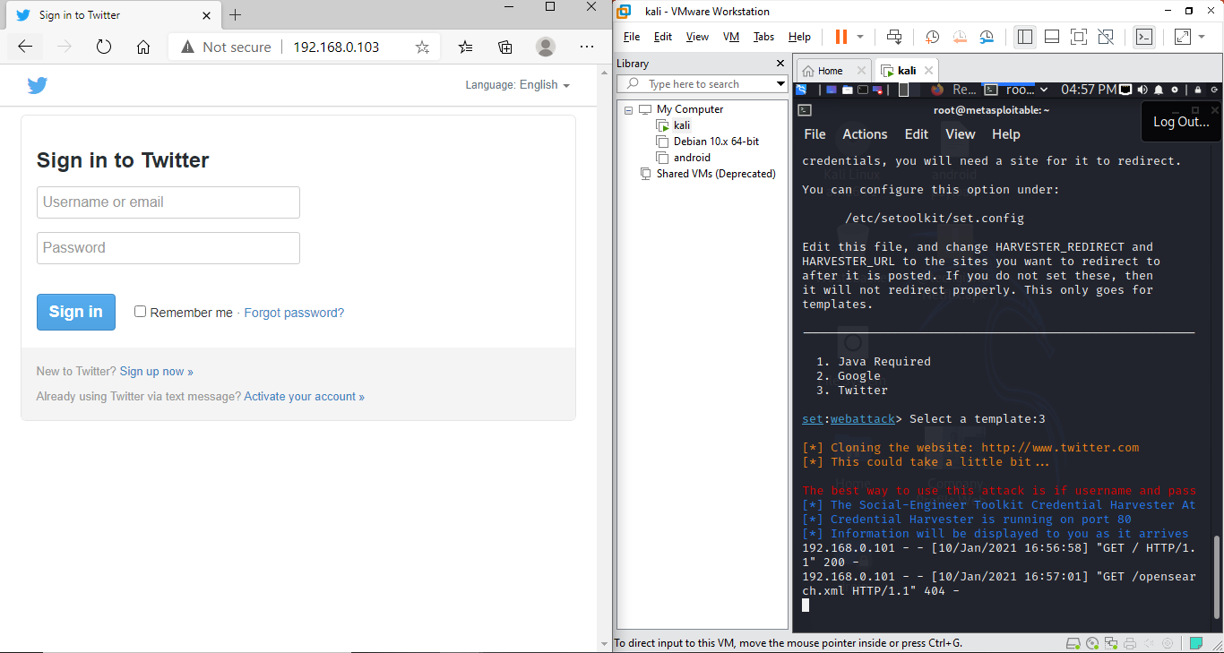
CREDENTIALS CAPTURE USING SETOOLKIT.
The target will access our IP address which will return twitter login page.
We immediately get a connection

Slide 28
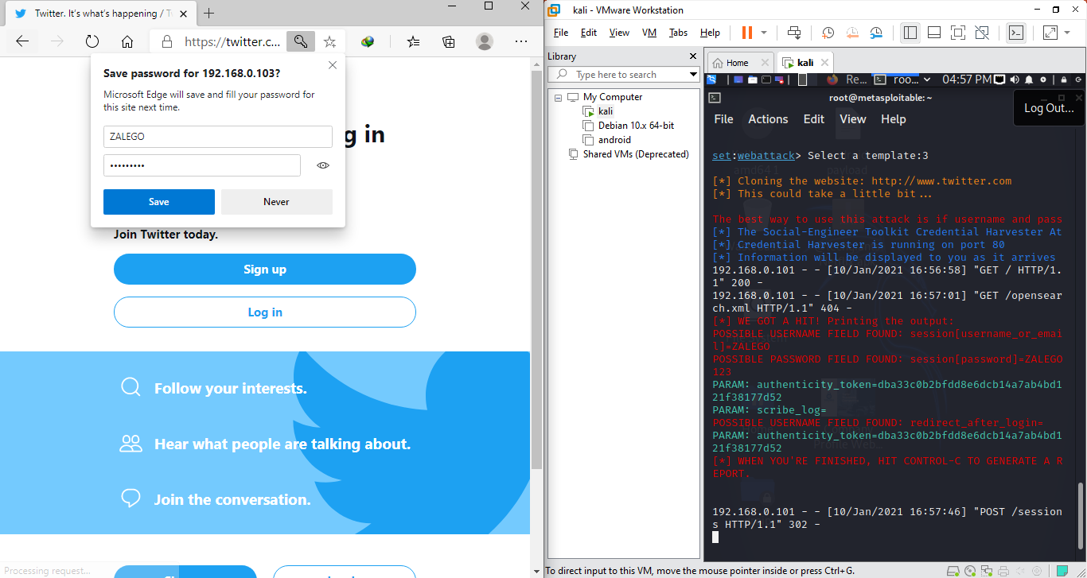
CREDENTIALS CAPTURE USING SETOOLKIT.
The target will access our IP address which will reload twitter login page.
We are capturing the inputs

Slide 29
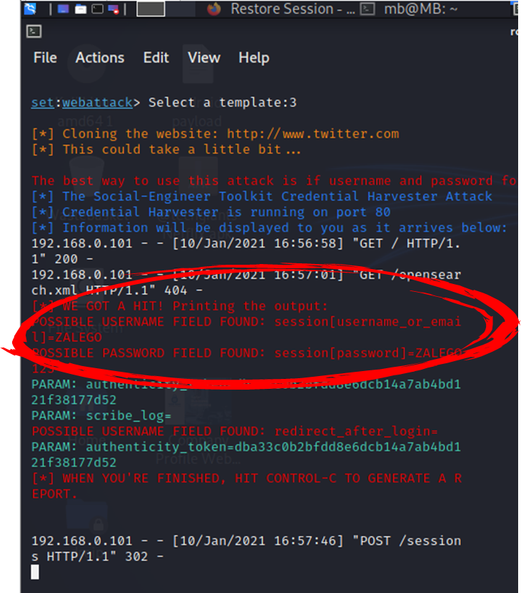
CREDENTIALS CAPTURE USING SETOOLKIT.
We captured the login details

Slide 30
CREDENTIALS CAPTURE USING SETOOLKIT CONCLUSION
Attackers use different methods to trick the target in giving up their personal information.
Users opt to be careful with the links they visit and ensure they are secure.

Slide 31
Password-CrackinG.

Slide 32
UNAUTHORIZED ACCESS: PASSWORD CRACKING.
What is Password Cracking?
Password cracking is the process of attempting to gain Unauthorized access to restricted systems using common passwords or algorithms that guess passwords.

Slide 33
Password-Cracking Techniques
Password-Cracking Techniques:
Dictionary Attacks
Syllable Attack
Rule-Based Attack
Brute-Force Attacks
Hybrid Attack
Packet Sniffing

Slide 34
Password-Cracking Techniques
Password-Cracking Techniques:
Dictionary Attacks
An attack of this type takes the form of a password-cracking application that has a dictionary file loaded into it.

Slide 35
Password-Cracking Techniques
Password-Cracking Techniques:
Syllable Attack
This type of attack is a combination of a brute-force attack and a dictionary attack.

Slide 36
Password-Cracking Techniques
Password-Cracking Techniques:
Rule-Based Attack
It assumes that the user has created a password using information the attacker has some knowledge of ahead of time.

Slide 37
Password-Cracking Techniques
Password-Cracking Techniques:
Brute-Force Attacks
Every possible combination of characters is attempted until the correct one is uncovered.

Slide 38
Password-Cracking Techniques
Password-Cracking Techniques:
Hybrid Attack
This form of password attack builds on the dictionary attack but with additional steps as part of the process.

Slide 39
Password-Cracking Techniques
Password-Cracking Techniques:
Hybrid Attack
This form of password attack builds on the dictionary attack but with additional steps as part of the process.

Slide 40

Password cracking demo
We are targeting metasploitable 2 port number 22. A service we discovered from the scans.
Presentation subtitle

Slide 41
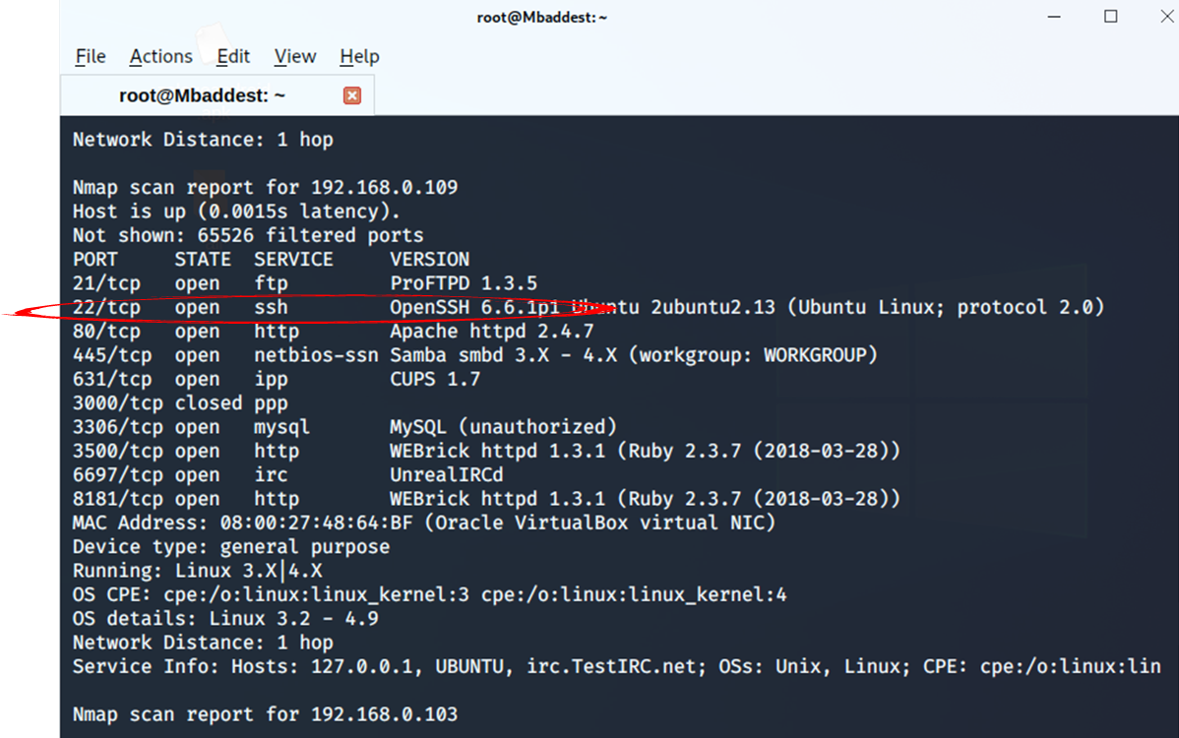
Password cracking demo:
TARGET PORT 22 (SSH)
Metasploitable Nmap scan results.
Password cracking port 22 ssh of our target

Slide 42
Password cracking demo:
WORDLIST.
Before we password crack our target. We need a word list which is a text file containing a collection of words for use in a password attack.
A word list consist of user and password text files.

Slide 43
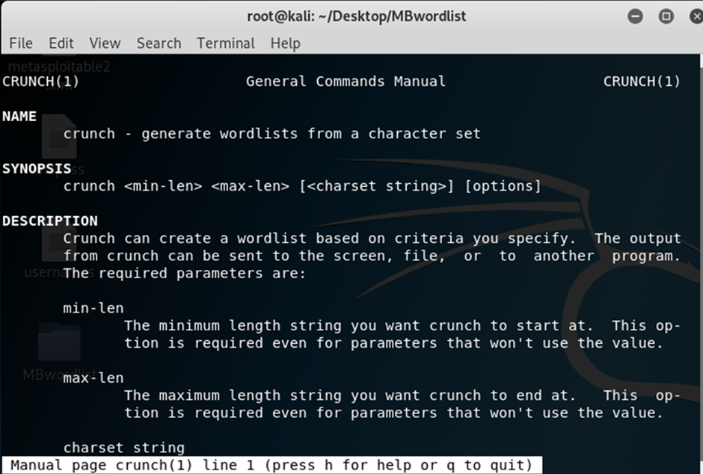
Password cracking demo: CREATING A
WORDLIST.
Creating a word list in Kali using crunch.
Crunch is a wordlist generator where you can specify a standard character set or a character set you specify.
It can generate all possible combinations and permutations.

Slide 44
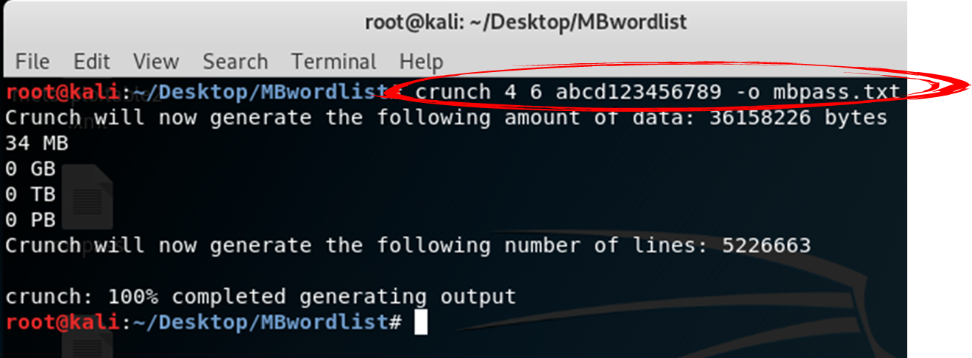
Password cracking demo: CREATING A
WORDLIST.
Creating a word list in Kali using crunch.
Run Crunch (command) 4 (min) 6 (max) abcd123456789 (characters)

Slide 45

Password cracking demo:
SSH cracking using hydra
Password cracking using hydra in kali.
Hydra is a parallelized login cracker which supports numerous protocols to attack.

Slide 46
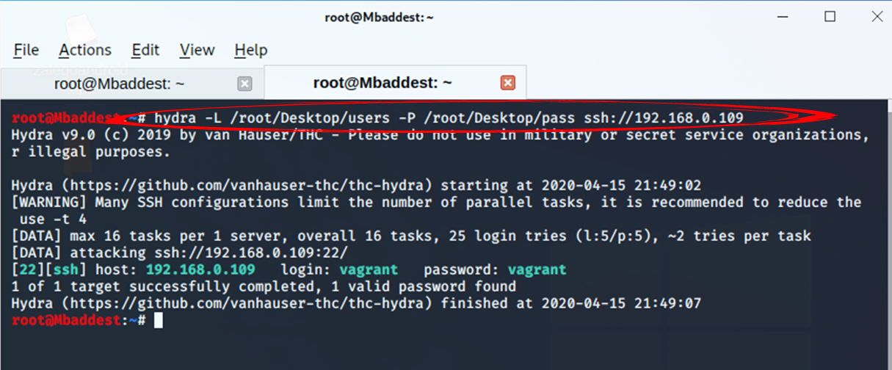
Password cracking demo:
SSH cracking using hydra
ssh password cracking with hydra in kali.
Running hydra -L (users list) –P (password list) ssh://(target IP)

Slide 47
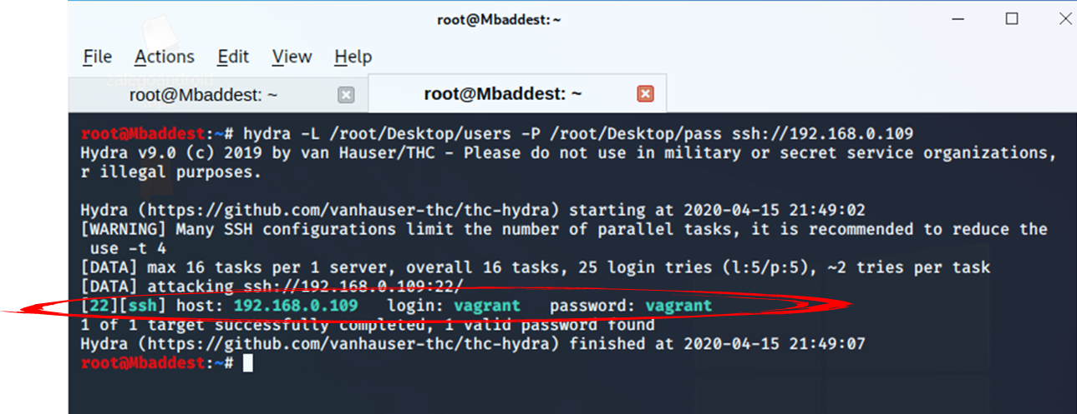
Password cracking demo:
SSH cracking using hydra
ssh password cracking with hydra in kali.
We are able to get the username and password for connecting to our target machine via ssh

Slide 48
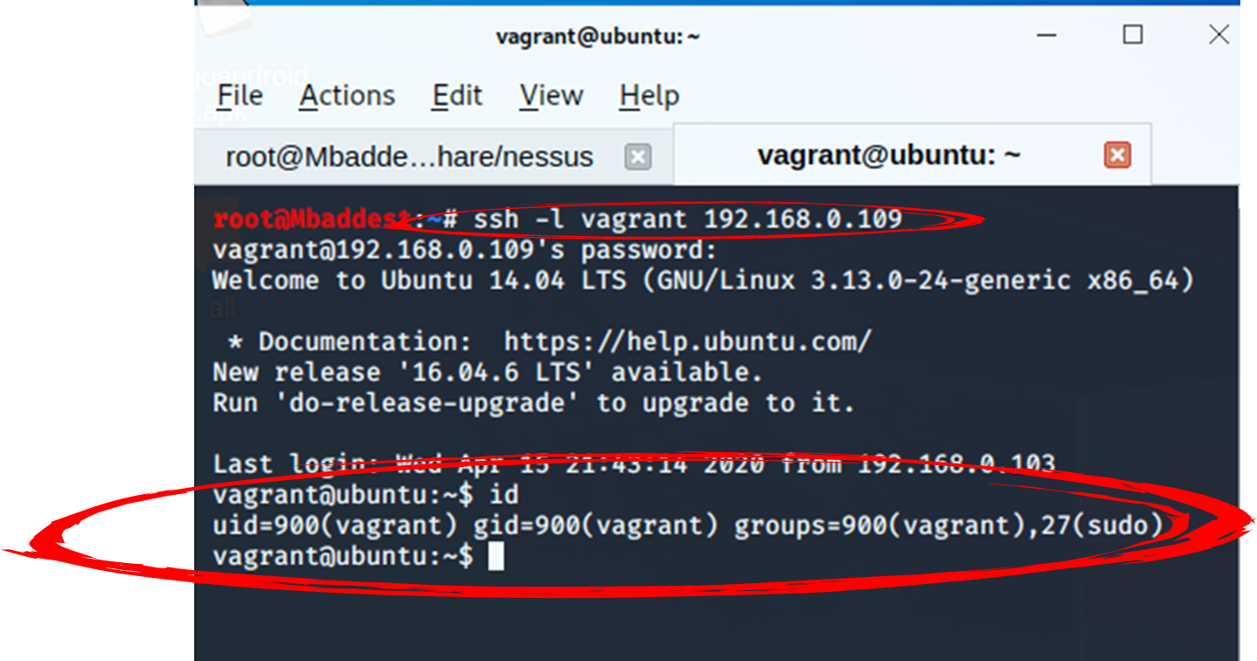
Password cracking demo:
SSH cracking using hydra
Connecting to ssh with the credentials.
Using the cracked user and password we are able to login to the target.

Slide 49

EXPLOITS :CLIENT SIDE EXPLOITATION.

Slide 50

CLIENT SIDE EXPLOITATION.
Client side attacks require user-interaction such as enticing them to click a link, open a document, or somehow get to your malicious website.

Slide 51
CLIENT SIDE EXPLOITATION.
We are going to create a payload that will be accessed by the client “target” via a link.

Slide 52
CLIENT SIDE EXPLOITATION.
We will create 3 payloads for the targets
Windows
Linux
Android

Slide 53
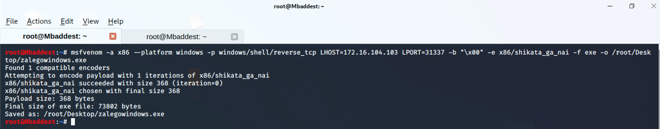
PAYLOAD CREATION USING MSFVENOM.
Creating windows Payloads using MFSVENOM

Slide 54
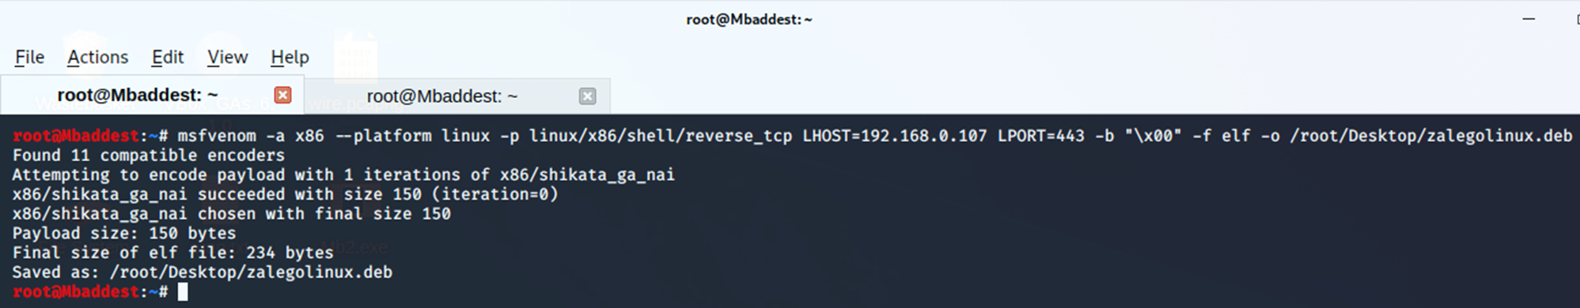
PAYLOAD CREATION USING MSFVENOM.
Creating Linux Payloads

Slide 55
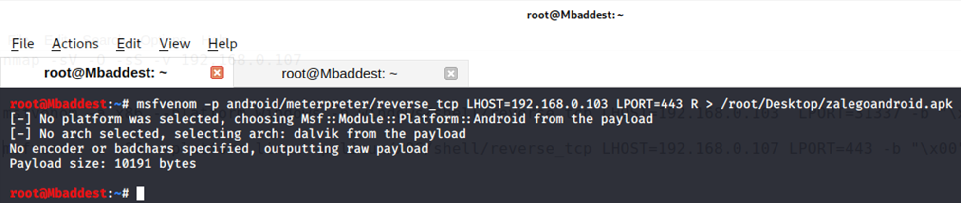
PAYLOAD CREATION USING MSFVENOM.
Creating Android Payloads

Slide 56

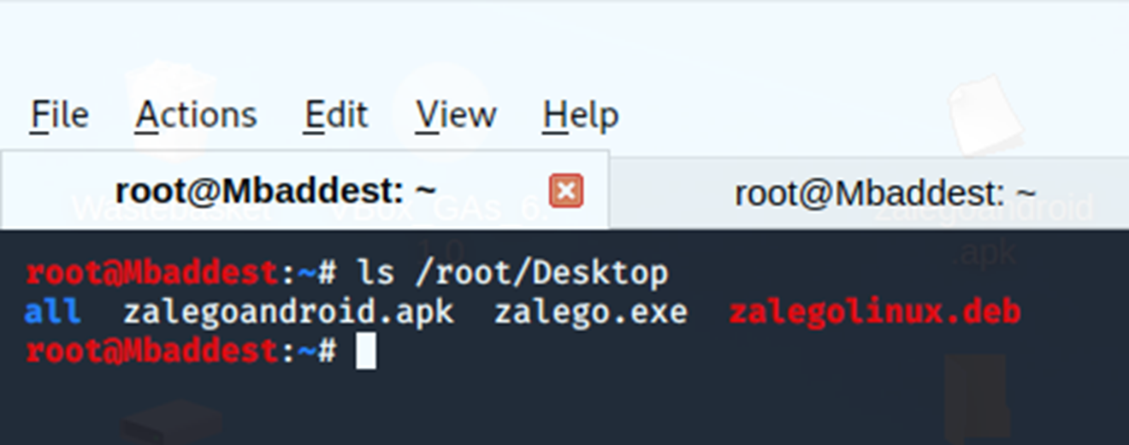
PAYLOAD CREATION USING MSFVENOM.
All payloads saved on the desktop.

Slide 57
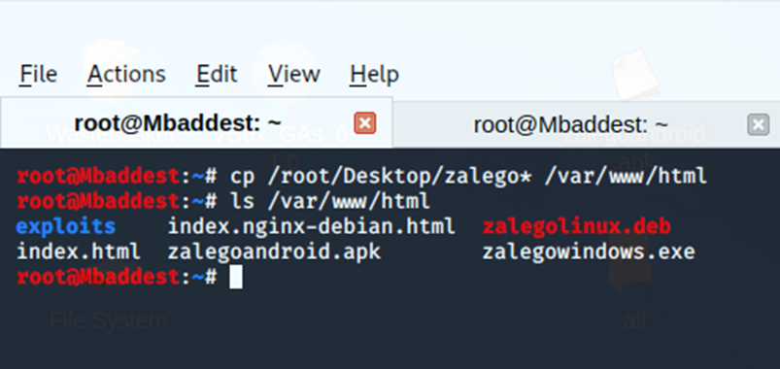
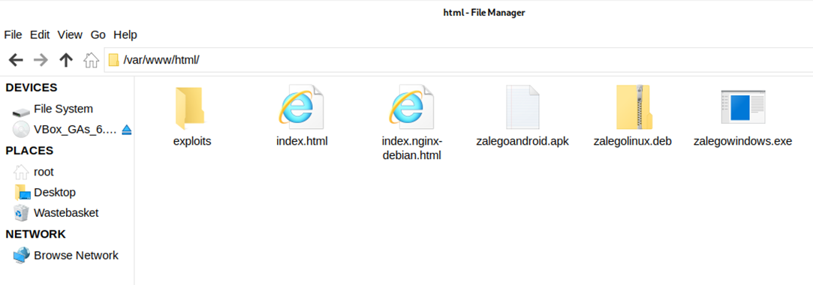
MOVING PAYLOADS TO APACHE FOLDER.
Copy/ move the payloads to html folder to access apache web service

Slide 58
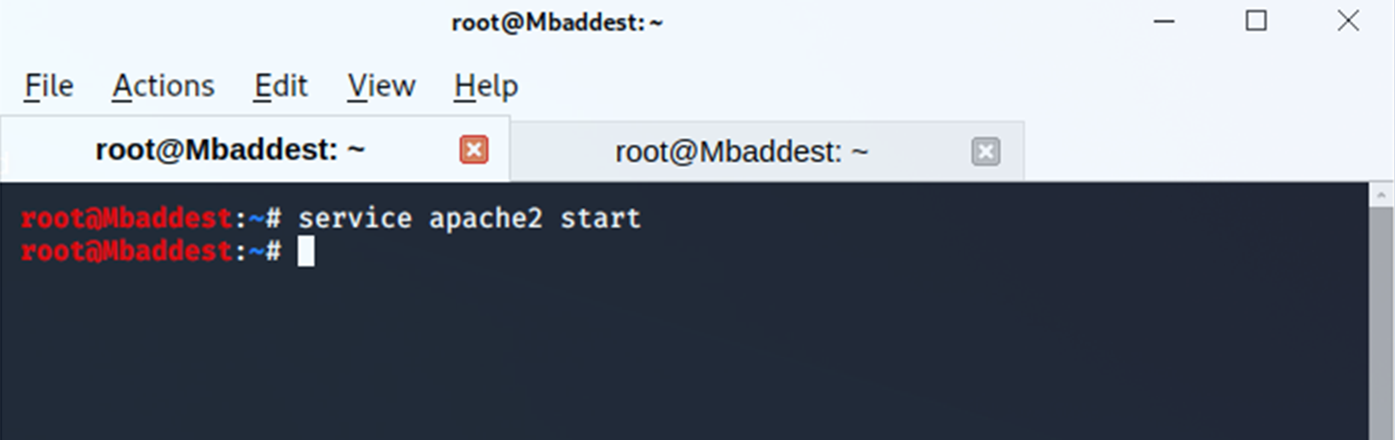
CLIENT SIDE EXPLOITATION.
Start Apache2 service in Kali Linux to expose the payload for download.

Slide 59
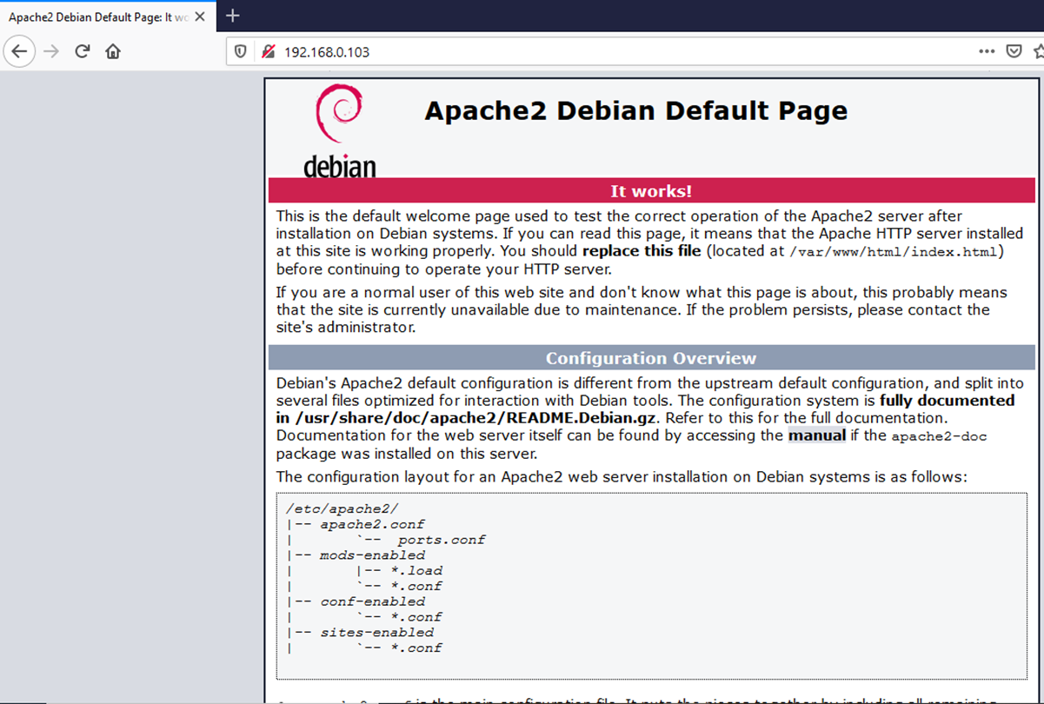
Client side exploitation.
Check if the apache web services is working.
Run your IP address on the browser to confirm if web service is working.

Slide 60
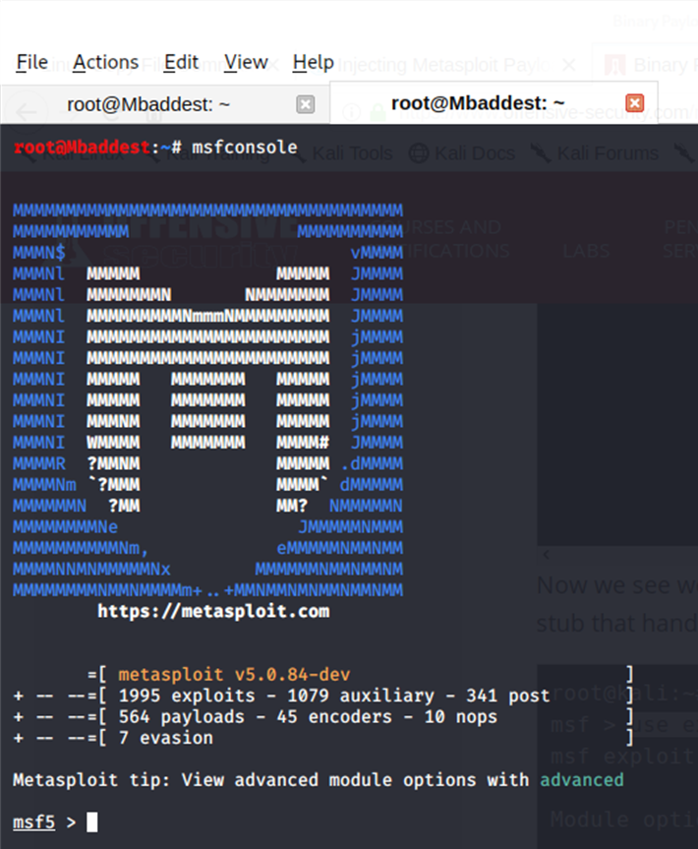
CLIENT SIDE EXPLOITATION: TARGETING WINDOWS SYSTEMS
Start msfconsole running msfconsole on the terminal.

Slide 61
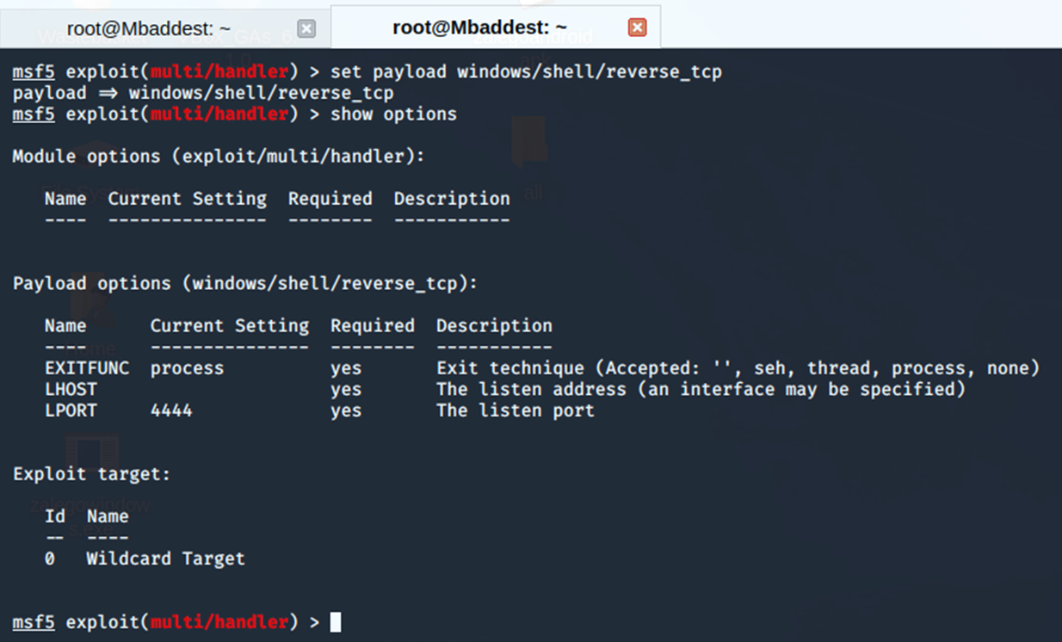
CLIENT SIDE EXPLOITATION: TARGETING WINDOWS SYSTEMS
Configure the payload
When using the exploit/multi/handler module, we still need to tell it which payload to expect so we configure it to have the same settings as the executable we generated.

Slide 62
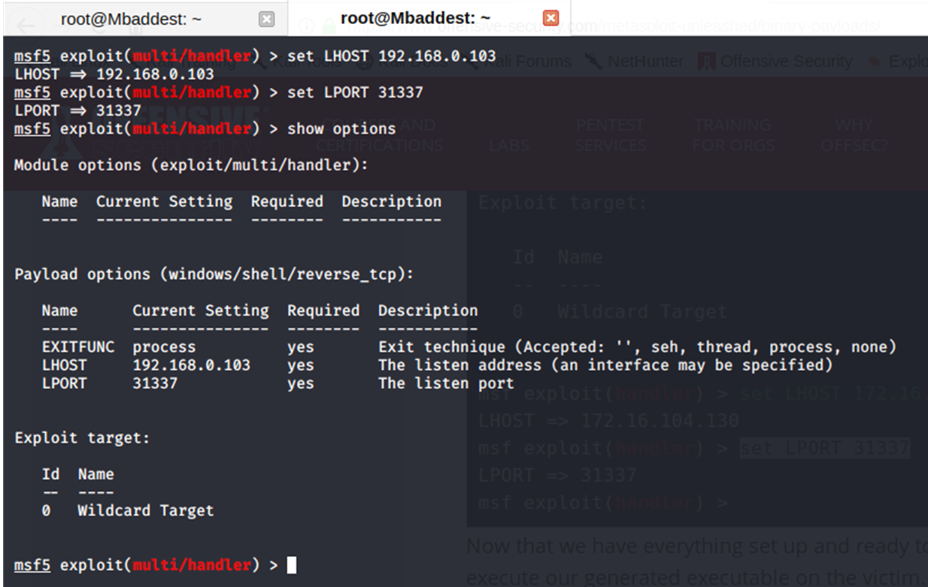
CLIENT SIDE EXPLOITATION: TARGETING WINDOWS SYSTEMS
Set the listening host and port.
Replace the IP address and port.

Slide 63
CLIENT SIDE EXPLOITATION: TARGETING WINDOWS SYSTEMS
Now that we have everything set up and ready to go, we run exploit for the multi/handler and execute our generated executable on the victim.
The multi/handler handles the exploit for us and presents us our shell.
Waiting for the target to download and run the payload.

Slide 64
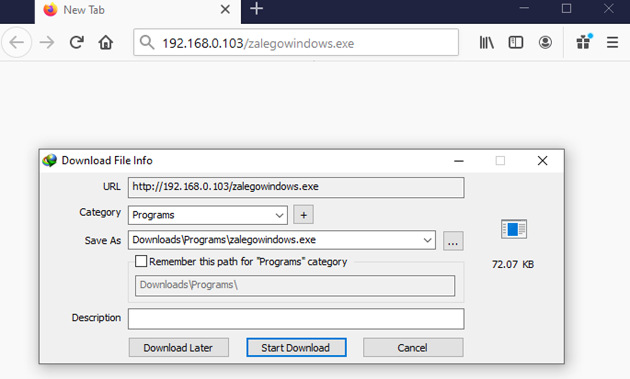
CLIENT SIDE EXPLOITATION: TARGETING WINDOWS SYSTEMS
The targets connects to the url/ IP to download the payload and run it

Slide 65
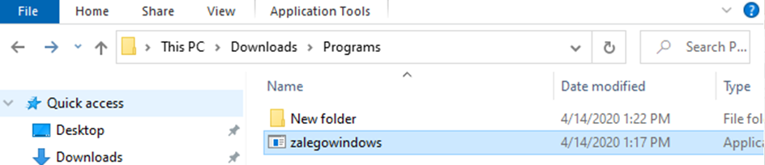
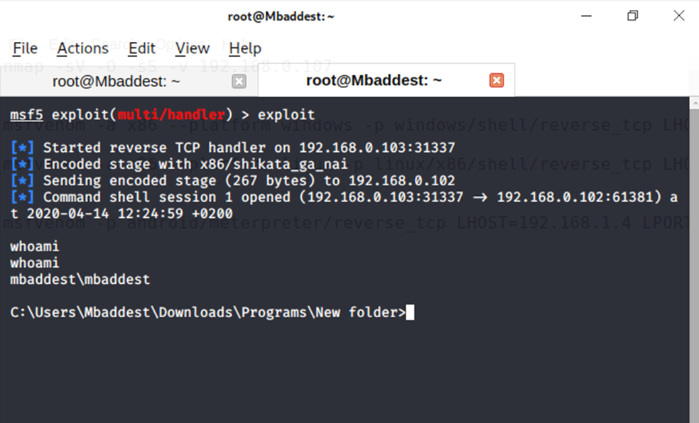
CLIENT SIDE EXPLOITATION: TARGETING WINDOWS SYSTEMS
A connection is successfully established on running the payload.

Slide 66

CLIENT SIDE EXPLOITATION: TARGETING android SYSTEMS
Lets establish connection to an android device.

Slide 67
CLIENT SIDE EXPLOITATION: TARGETING android SYSTEMS
Remember the android payload we created earlier?

Slide 68
CLIENT SIDE EXPLOITATION: TARGETING android SYSTEMS
Start msfconsole and use multi/handler, which is a stub that handles exploits launched outside of the framework.

Slide 69
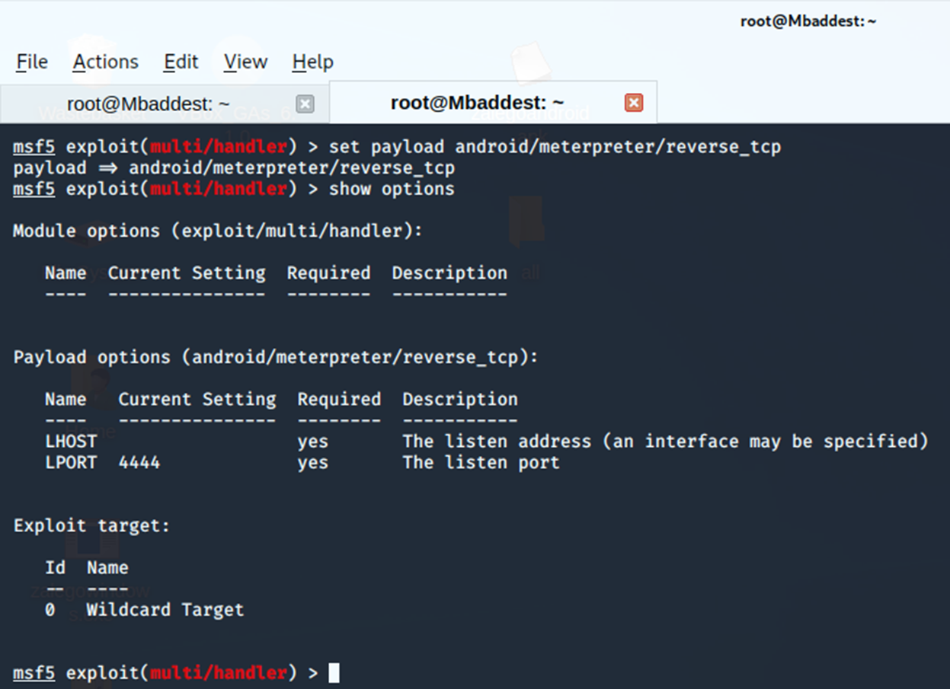
CLIENT SIDE EXPLOITATION: TARGETING android SYSTEMS
When using the exploit/multi/handler module, we still need to tell it which payload to expect so we configure it to have the same settings as the executable we generated.
Setting the payload.

Slide 70
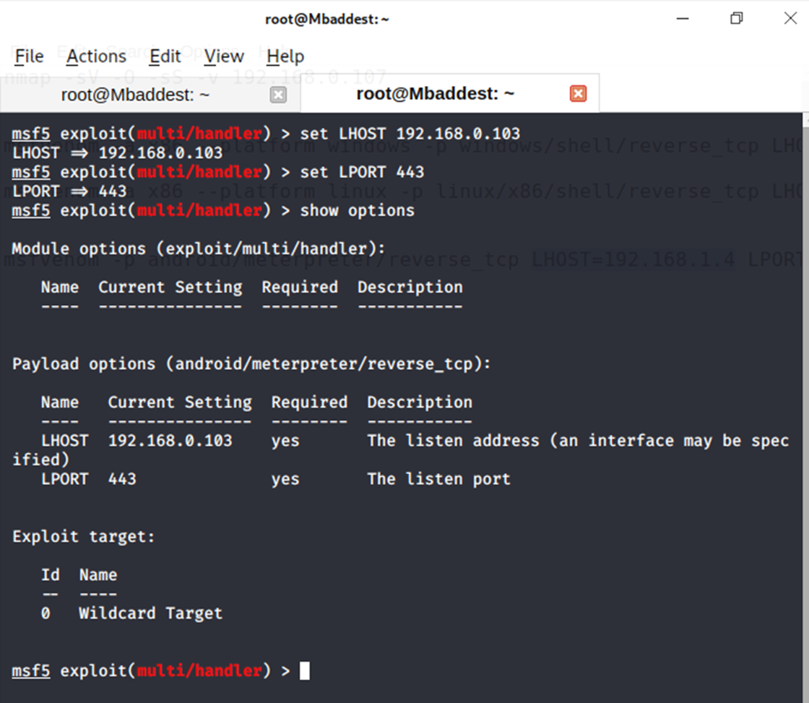
CLIENT SIDE EXPLOITATION: TARGETING android SYSTEMS
Set the listening host and port

Slide 71
CLIENT SIDE EXPLOITATION: TARGETING android SYSTEMS
Set the listening host and port
Exploit and wait for target connection.

Slide 72
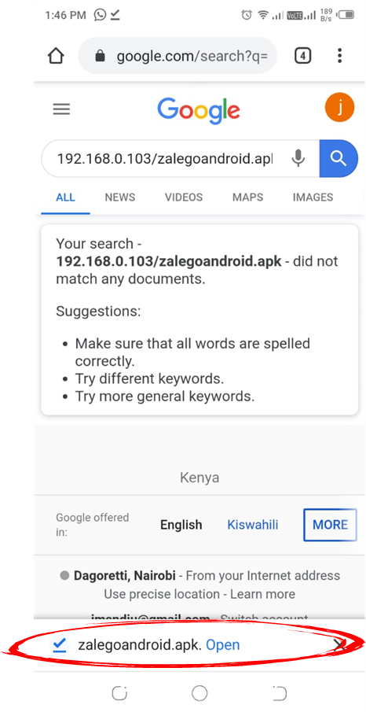
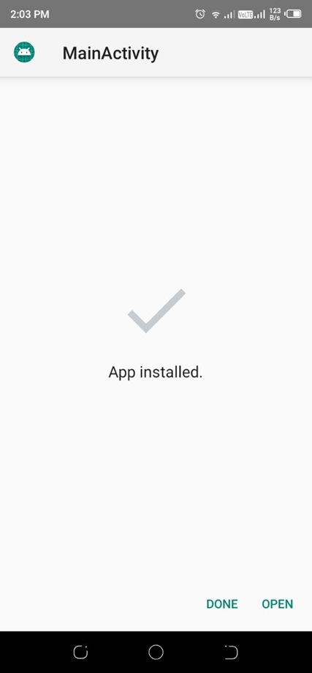
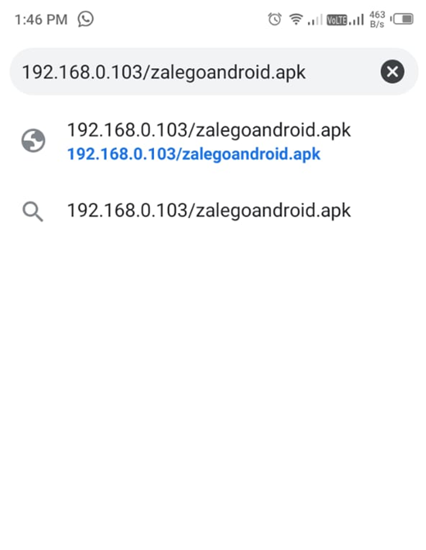
CLIENT SIDE EXPLOITATION: TARGETING android SYSTEMS
The target access and downloads the payload via url/ IP

Slide 73
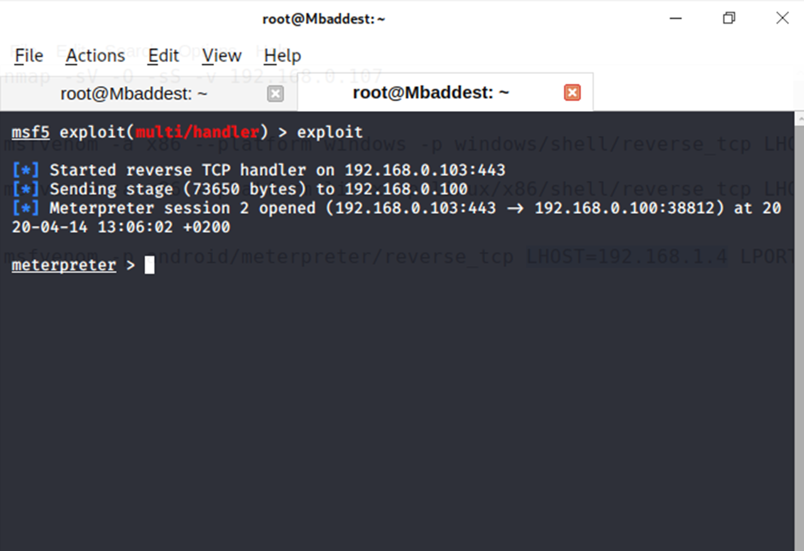
CLIENT SIDE EXPLOITATION: TARGETING android SYSTEMS
A connection is successfully established on running the payload.

Slide 74
CLIENT SIDE EXPLOITATION: conclusion
we described the client side attacks or exploitations. The same principal applies to any combination of operating systems and client applications running on them.
It’s obvious what needs to be done in order to prevent this kind of attack: patch our systems and applications and train our users about risks that social engineering and phishing attacks involve.

Slide 75
REMOTE SIDE EXPLOITATION:

Slide 76
REMOTE SIDE EXPLOITATION:
Remote exploitation techniques are used to exploit a product or a component of a product by an attacker who does not have access to the computer being targeted.

Slide 77
REMOTE SIDE EXPLOITATION:
Although there are some network services and management consoles for which remote ­exploitation can be considered server-side exploitation, the biggest attack surface, and the one that is always available when targeting such products, is actually the ­client-side part.
This section focuses on the remote exploitation of client-side components.

Slide 78
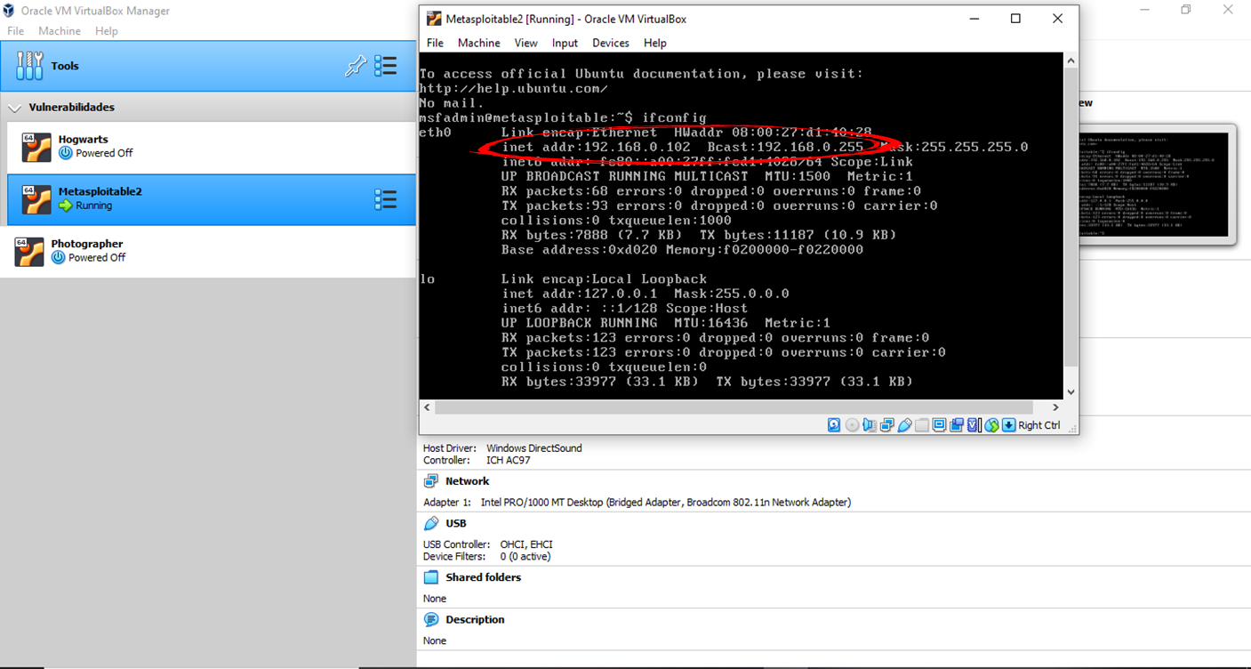
REMOTE SIDE EXPLOITATION DEMO:TARGET METASPLOITABLE2

Slide 79
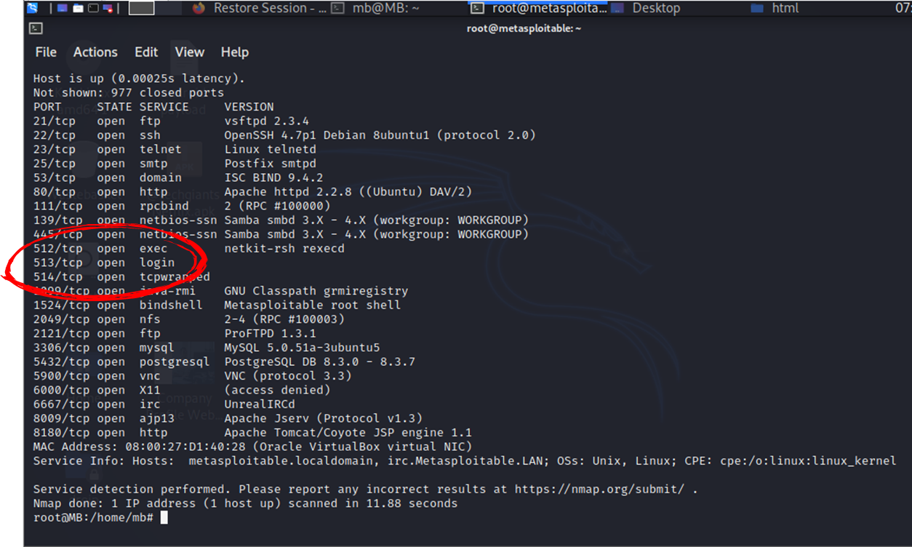
REMOTE SIDE EXPLOITATION DEMO:TARGET METASPLOITABLE2
Remember the list of open ports which we came up across during the port scan? Ports 512,513 and 514 are there for remotely accessing Unix machines.

Slide 80
REMOTE SIDE EXPLOITATION DEMO:TARGET METASPLOITABLE2
The ports have been misconfigured in such a way that anyone can set up a remote connection without proper authentication.

Slide 81
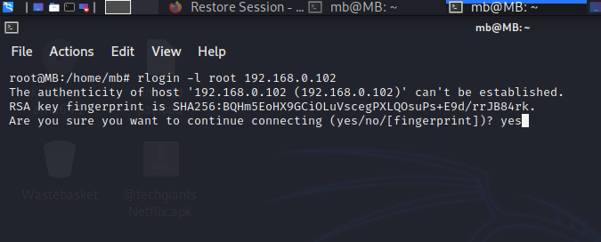
METASPLOITABLE 2: Remote access vulnerability – Rlogin.
We will use rlogin to remotely login to Metasploitable 2.

Slide 82
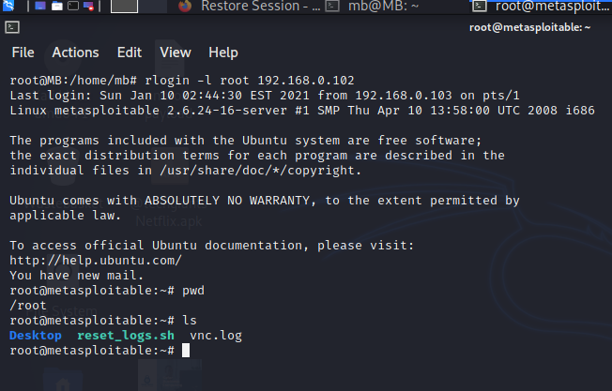
METASPLOITABLE 2: Remote access vulnerability – Rlogin.
We have successfully connected to our target.

Slide 83
METASPLOITABLE 2: Telnet Vulnerability.

Slide 84
METASPLOITABLE 2: Telnet Vulnerability.
On port 21, Metasploitable 2 runs VSFTPD, a popular FTP server. The version that is installed on Metasploit contains a backdoor.
The backdoor was quickly identified and removed, but not before quite a few people downloaded it.

Slide 85
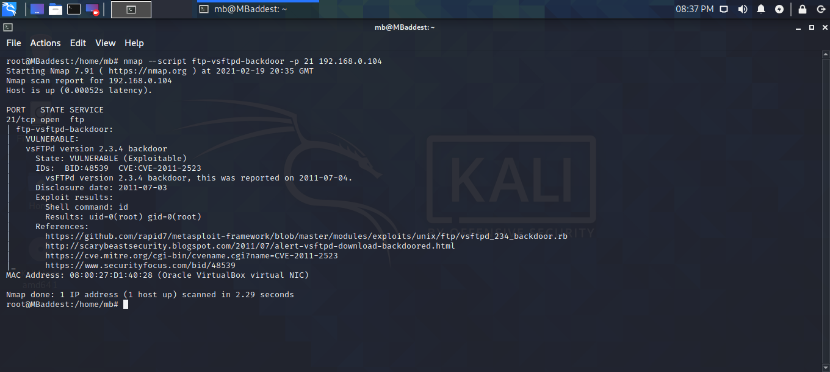
METASPLOITABLE 2: Telnet Vulnerability.
To determine if the FTP service contains a backdoor without actually gaining a shell we can use an Nmap script.
Nmap script ftp-vsftpd-backdoor tests the VSFTPD v2.3.4 installation for the backdoor.

Slide 86
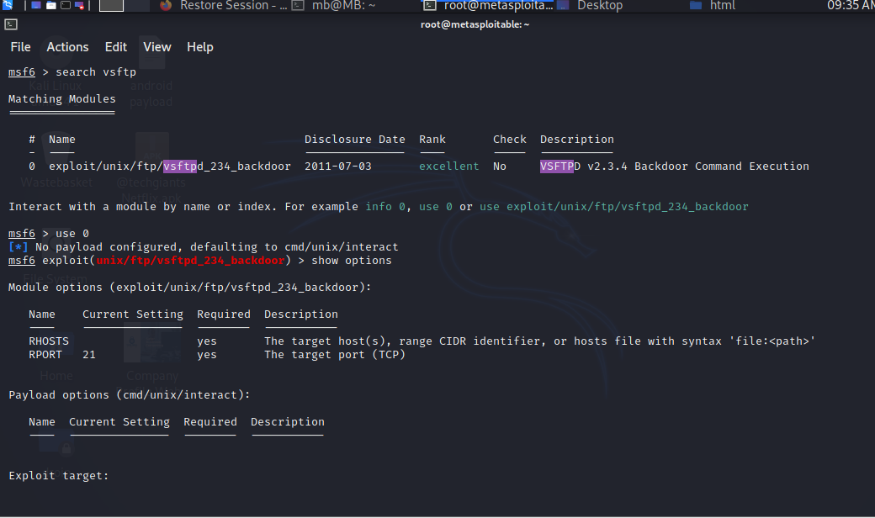
METASPLOITABLE 2: Telnet Vulnerability.
Let us start Metasploit, search and use for vsftp vulnerability.

Slide 87
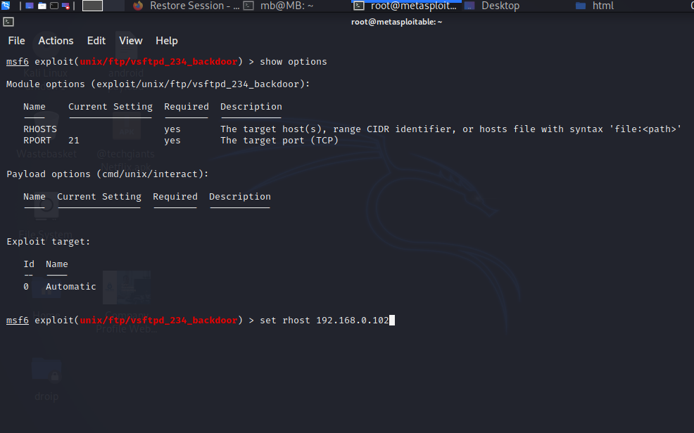
METASPLOITABLE 2: Telnet Vulnerability.
Set rhosts

Slide 88
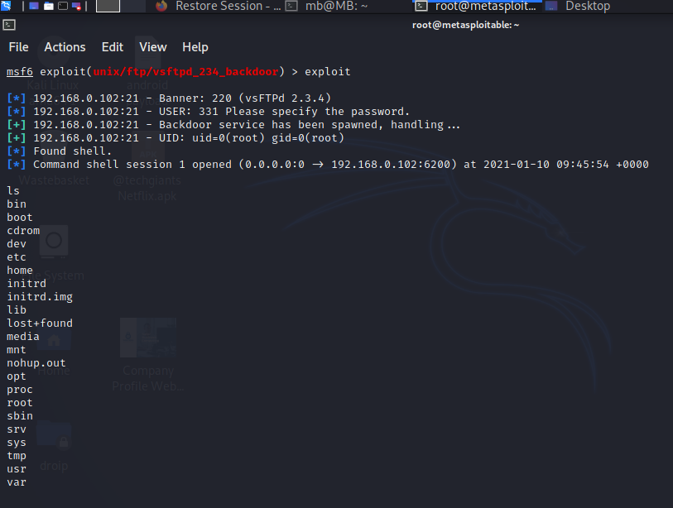
METASPLOITABLE 2: Telnet Vulnerability.
Run exploit by pressing enter

Slide 89
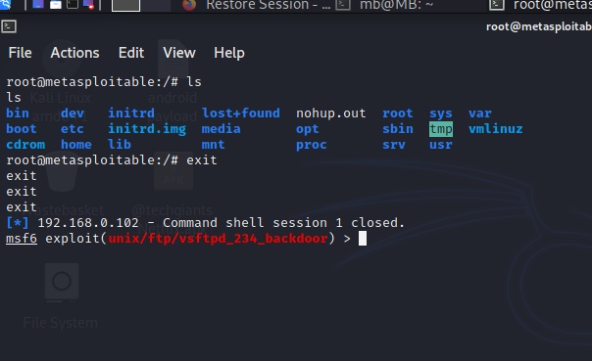
METASPLOITABLE 2: Telnet Vulnerability.
We successfully exploited vsftp.

Slide 90
Remote exploitation conclusion
we described the remote side attacks or exploitations. The same principal applies to any combination of operating systems and applications running on them.
It occurs due to the poorly written server-side codes where the input parameters are not properly sanitized or validated.

Slide 91

POST EXPLOITATION.
Presentation subtitle

Slide 92

WHAT IS POST exploitation
Post-exploitation refers to any actions taken after a session is opened.
A session is an open shell from a successful exploit or brute force attack.
A shell can be a standard shell or Meterpreter.

Slide 93
POST exploitation CONT…
After working so hard to successfully exploit a system, what do we do next?
A pen-tester may also opt to sniff packets for other potential victims, edit their registries to gain further information or access, or set up a backdoor to maintain more permanent system access.

Slide 94
POST exploitation CONT…
We will be exploiting Metasploitable 3 or 2.
We will search for confidential files in our target.

Slide 95
POST exploitation DEMO:
TARGET: METASPLOITABLE 2

Slide 96
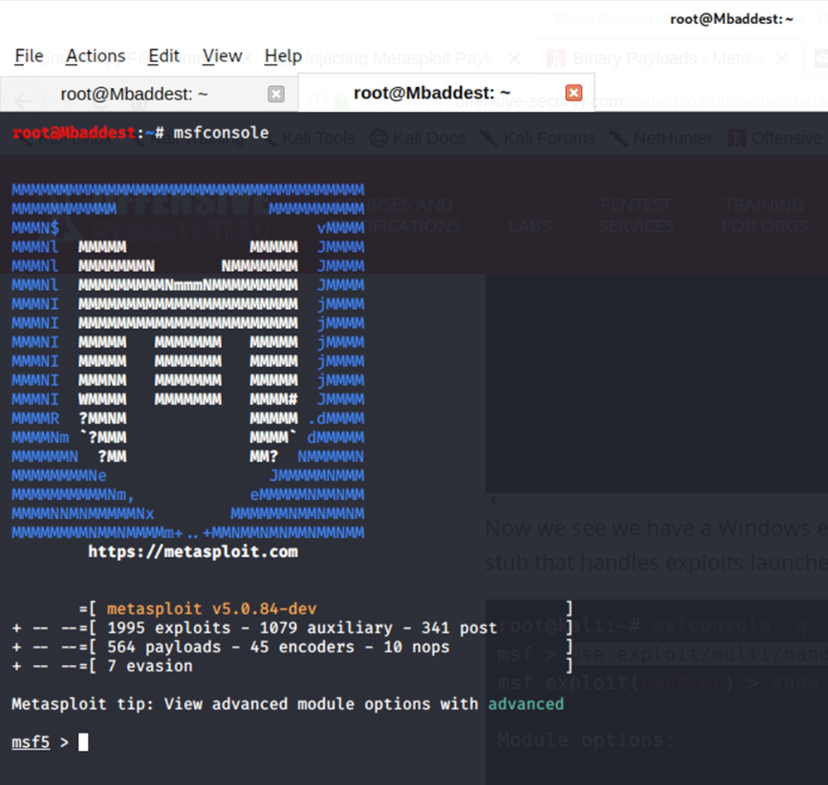
POST exploitation DEMO:
TARGET: METASPLOITABLE 2
Start msfconsole

Slide 97

POST exploitation DEMO:TARGET: METASPLOITABLE 2
We will exploit one vulnerability (vsftp)
Then dump password hashes which can be used to discover users passwords.

Slide 98
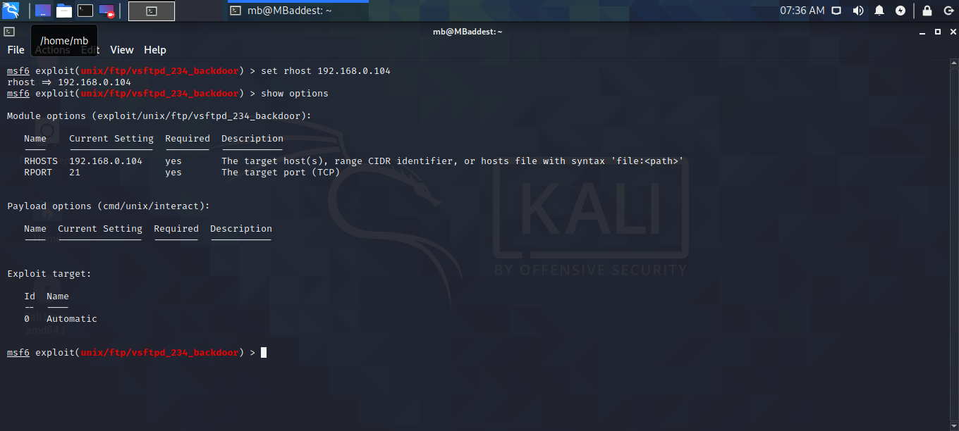
POST exploitation DEMO:TARGET: METASPLOITABLE 2
Set rhost (target IP address)

Slide 99
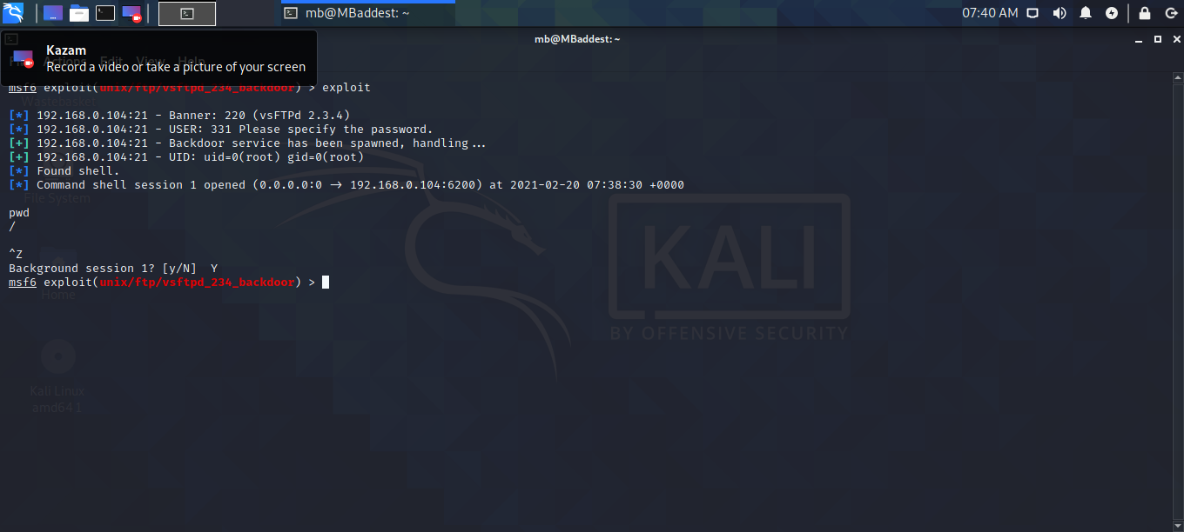
POST exploitation DEMO:TARGET: METASPLOITABLE 2
Successful Exploit
Press ctrl+z to run the session on background

Slide 100
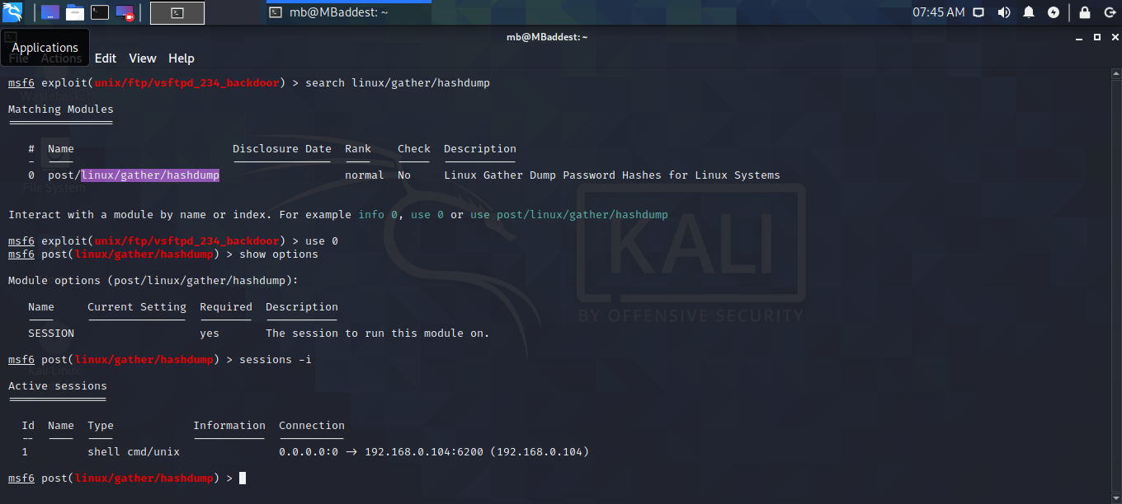
POST exploitation DEMO:TARGET: METASPLOITABLE 2
We will use a post module linux/gather/hashdump to collect password hashes.
Search and use linux/gather/hashdump

Slide 101
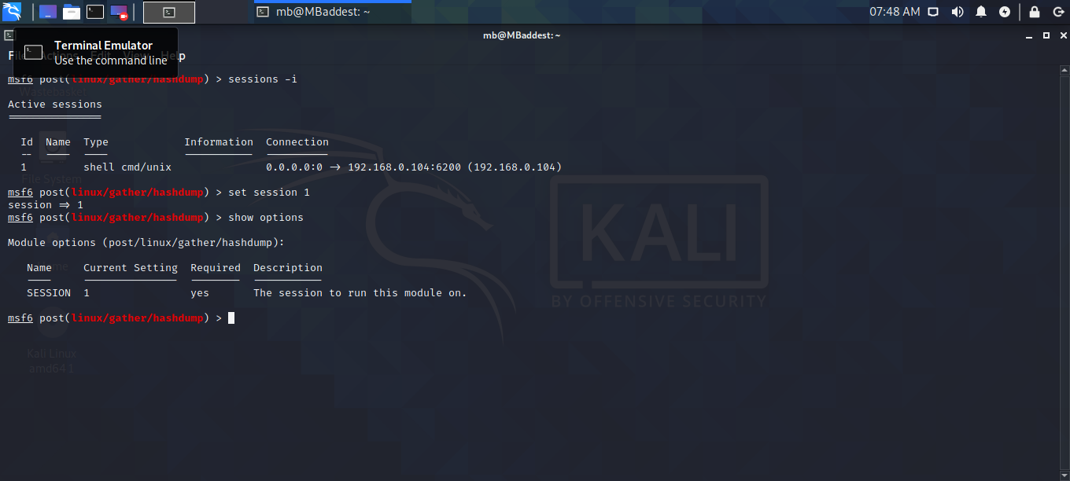
POST exploitation DEMO:TARGET: METASPLOITABLE 2
It requires session to be set
Select session 1

Slide 102

POST exploitation DEMO:TARGET: METASPLOITABLE 2
Exploit
What you see on your screen are users and password hash information.

Slide 103

POST exploitation DEMO:TARGET: METASPLOITABLE 2
Hashed passwords are then cracked using password cracking techniques or tools to retrieve plain text passwords which we can then use on login fields.

Slide 104
Conclusion
Vulnerability scanning intends to expose points of exploitation to a system.
Exploitation is geared towards initiating a connection with the target.
Post exploitation is getting to unearth more about the target.

Slide 105
Summary
Testers should act like a real hacker and test the application or system and needs to check whether a code is securely written.
A penetration test will be effective if there is a well-implemented security policy.
Penetration testing policy and methodology should be a place to make penetration testing more effective.

